Slide 1
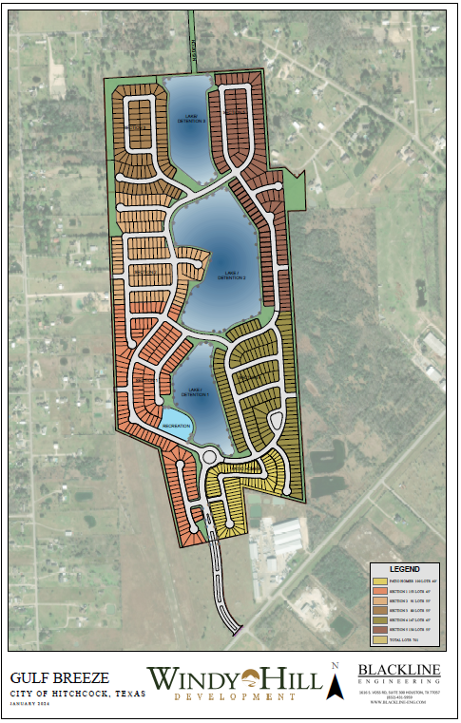
Proposed Gulf Breeze Residential Community March 6, 2024

Slide 2
Presentation Outline
Project Description
Development Process/Approvals Process
Drainage Plan Process Overview
Gulf Breeze Drainage Analysis/Results
Discussion

Slide 3
Gulf Breeze Project Description
224 Acres
701 homes planned
301 55’ lots
300 45’ lots
100 40’ patio home lots
45.3 acres detention reserves
Plus 30’ perimeter grading/drainage reserves (+- 9ac)
24% of the total land area
2.3-acre Recreation/Park Area
Water and Sanitary Sewer extended to site along FM 2004
Traffic signal and turn lanes at FM 2004
Emergency Access only connection to Dispensary Dr.

Slide 4
Development Process/Approvals Milestones
Zoning
PDD provides the allowable lot sizes but also places numerous restrictions
Subdivision Plats
Preliminary & Final
Drainage Report
City of Hitchcock and Galveston Drainage District #1
Traffic Impact Analysis
City of Hitchcock and TxDOT
Infrastructure Plans – Review/Approval, Inspection, and Acceptance
Grading, water, sanitary sewer, storm sewer, paving
City of Hitchcock and Galveston Drainage District #1
Home Construction
City plan review, permitting, and inspection

Slide 5
Drainage Plan Process
Analyze existing conditions
Drainage area maps
Flow paths and flow rates
Proposed conditions
Allowable release rate
Detention analysis and pond sizing

Slide 6
Gulf Breeze Drainage Analysis/Results
EXISTING CONDITIONS DRAINAGE AREAS
The southern portion of site flows generally drain east to west before entering Willow Bayou
The northern portion of the site flows northerly towards the North/South Ditch and Jay Road Ditch

Slide 7
Existing Conditions Flow Patterns

Slide 8
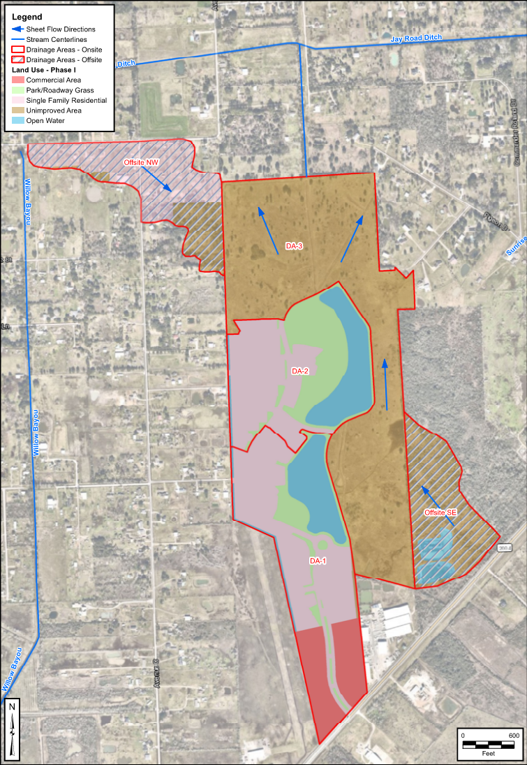
Gulf Breeze Drainage Analysis/Results
PHASE 1 CONDITIONS DRAINAGE AREAS
Majority of the flow which drains west is directed into onsite detention facilities.
Some portions are captured in onsite swales located on the eastern boundaries and the northwest corner.
Flow that currently drains west off the site is almost completely eliminated.

Slide 9
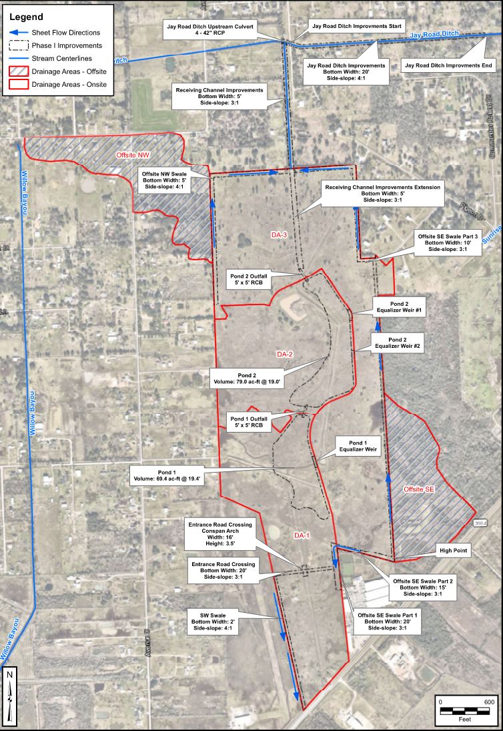
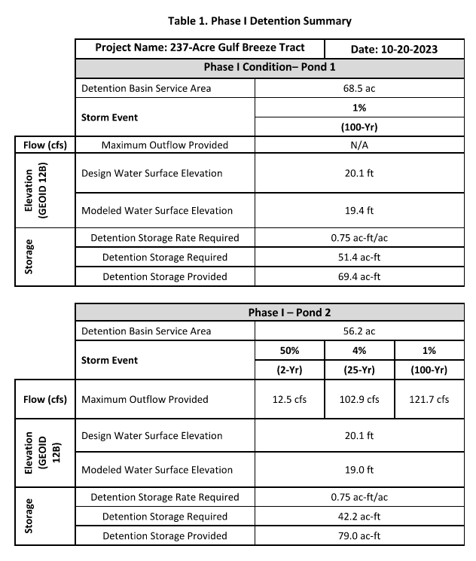
Phase 1 Proposed Drainage Solution

Slide 10
Phase 1 Proposed Flow Patterns

Slide 11
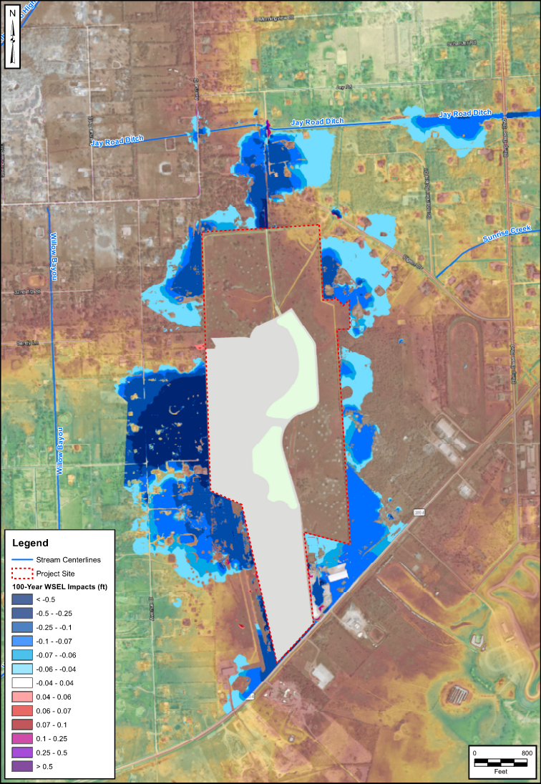
Gulf Breeze Drainage Analysis/Results
PHASE 1 WATER SURFACE COMPARISON
0.5 feet of reduction in Water Surface Elevation (WSE) in darker blue areas
Perceived increases at small isolated locations

Slide 12
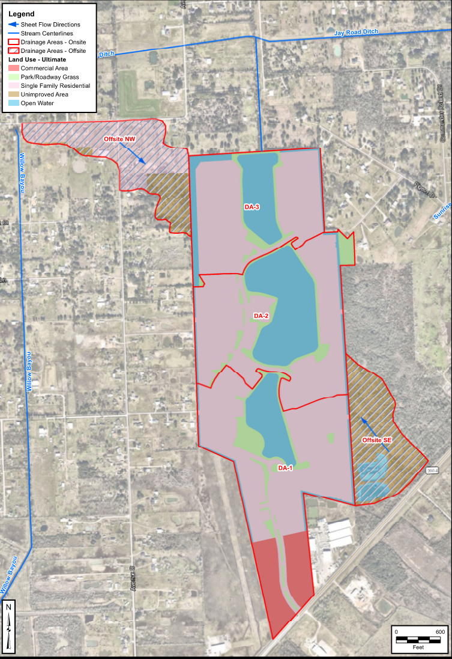
Gulf Breeze Drainage Analysis/Results
ULTIMATE CONDITIONS DRAINAGE AREAS
All flow outside the property boundary is captured within in swales along the property boundary.
All flow within the property is captured within detention basins that ultimately outfall into the North/South Ditch.

Slide 13
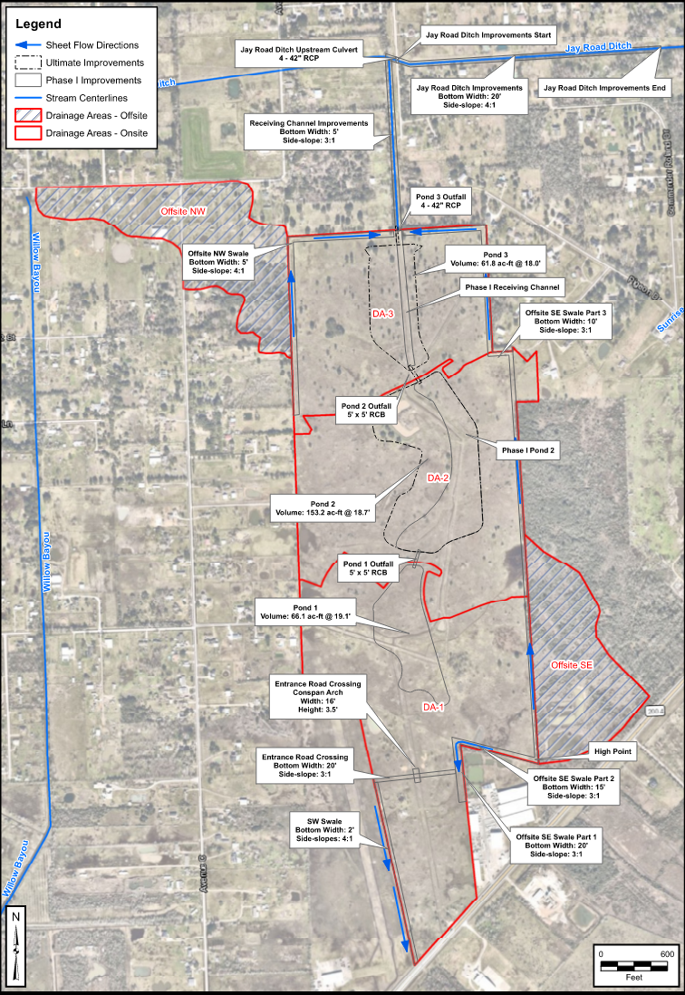
Ultimate Conditions Proposed Drainage Solution

Slide 14
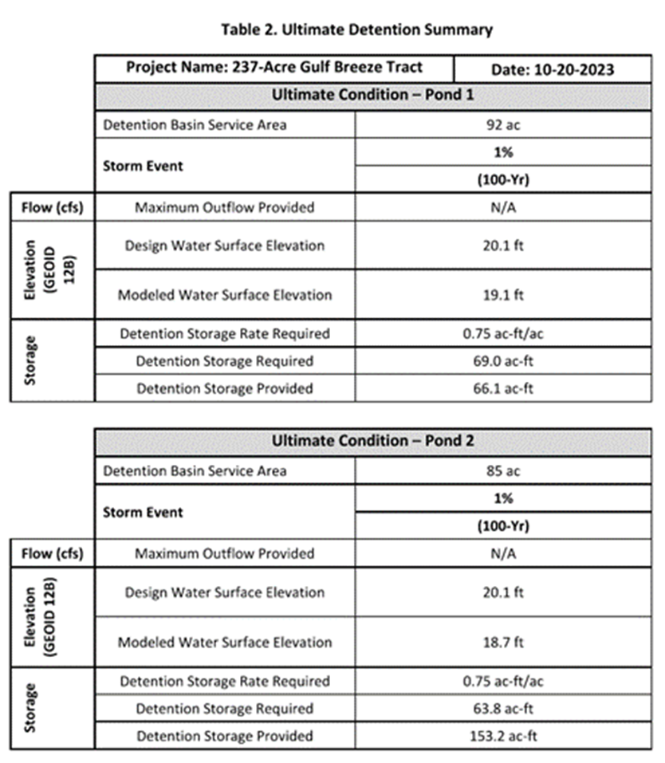
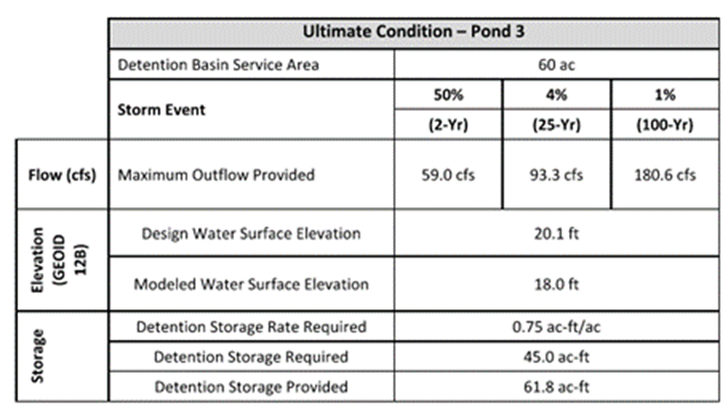
Ultimate Conditions Proposed Flow Patterns & Detention
Overall Detention Summary:
Required: 177.8 ac-ft Provided 281.1 ac-ft

Slide 15
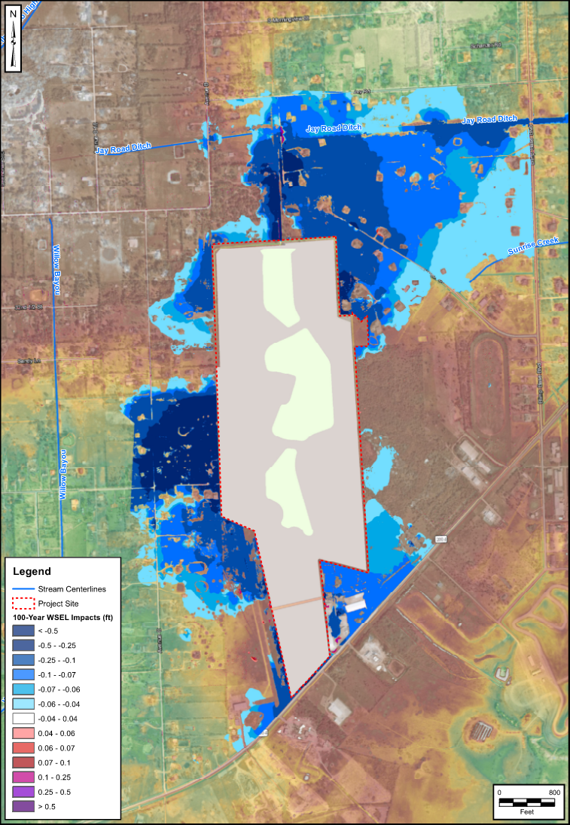
Gulf Breeze Drainage Analysis/Results
ULTIMATE WATER SURFACE COMPARISON
0.5 feet of reduction in WSE in darker blue areas.
Area of benefit much larger to the northeast due to additional detention, which now captures and detains flow that once exited the site.
Perceived increases at small isolated locations.

Slide 16
Discussion

